Slide 1
COMP 6411 - Comparative Study Of Programming Language
Kshitij Yerande - 40194579
Mrinal Rai - 40193024
Akshay Dhabale - 40163636
Farheen Jamadar - 40194668
Almas Saba - 40156359
Seung Hyun Hong - 26724701
Ujjawal Aggarwal - 40183962
Nastaran Naseri - 40215694
Submitted to:
Professor Kerly Titus

Slide 2










Introduction
Designed by James Gosling in 1991 at Sun Microsystems
Popular Java and Python Frameworks and Libraries
Real World Application
Java
Evolved from JDK 1.0 to JDK 18
Desktop GUI
Web Application
Mobile Application
Enterprise Application
Python was created in the late 1990s by Guido van Rossum at Centrum Wiskunde & Informatica
Python
Web Application
Artificial Intelligence
Evolved from Python 1 to Python 3.10.5
Data Science
Game Development

Slide 3
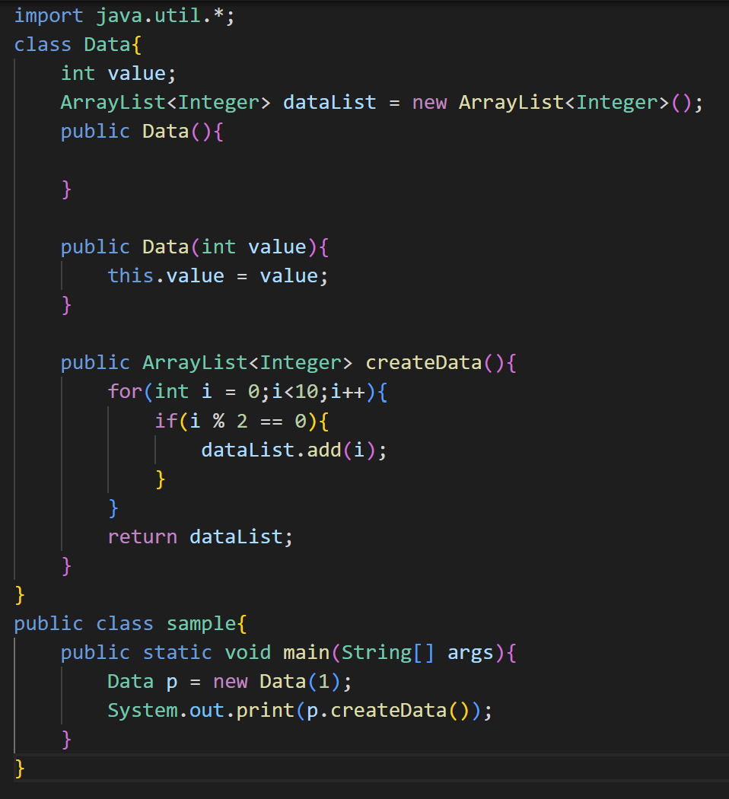
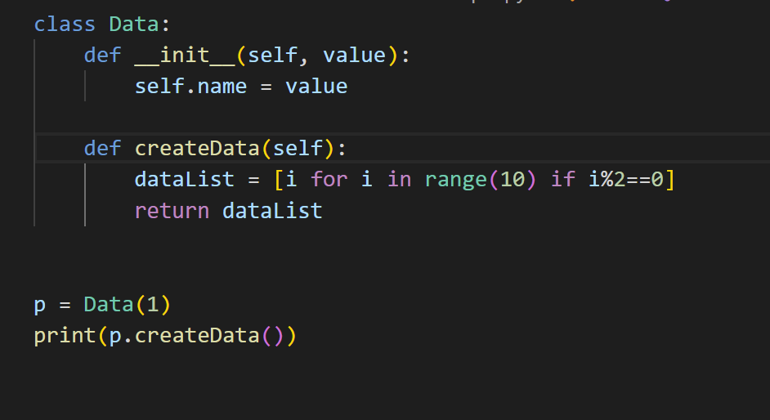
Language Constructs
Java is statically typed python is dynamically typed
Java Method needs return type. Python method does not require return type in method signature.
Java code is longer. Python code is shorter. Python supports list comprehension
Java uses curly braces, python uses indentation

Slide 4
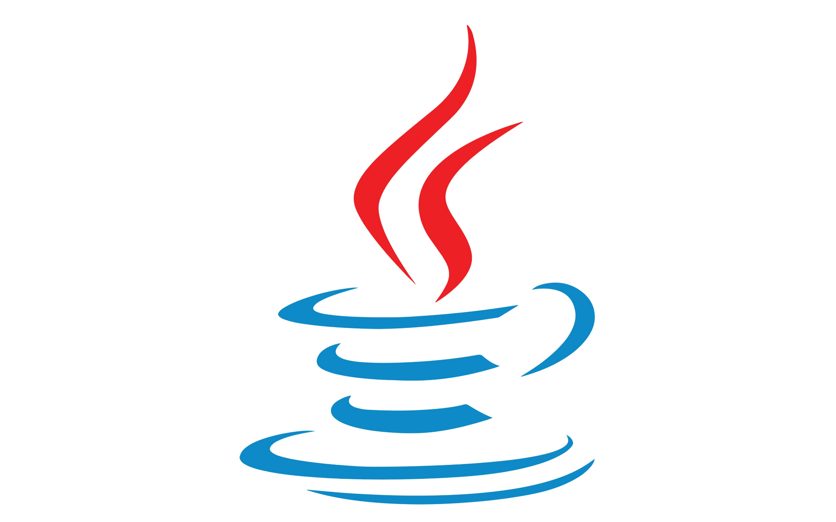

Java vs Python
Parameter
Compilation | Java is compiled language | Python is interpreted language
String Operations | Offers limited string related functions | It offers lots of string related functions.
Learning Curve | Complex learning curve | Easy to learn
Speed | Java program is faster | Python program is slower than java
Multiple Inheritance | Java supports partial multiple inheritance through interfaces. | Python supports multiple inheritance
Paradigm | Java supports imperative, object oriented, functional, reflective and concurrent paradigm | Python supports imperative, functional, procedural and reflective paradigm

Slide 5
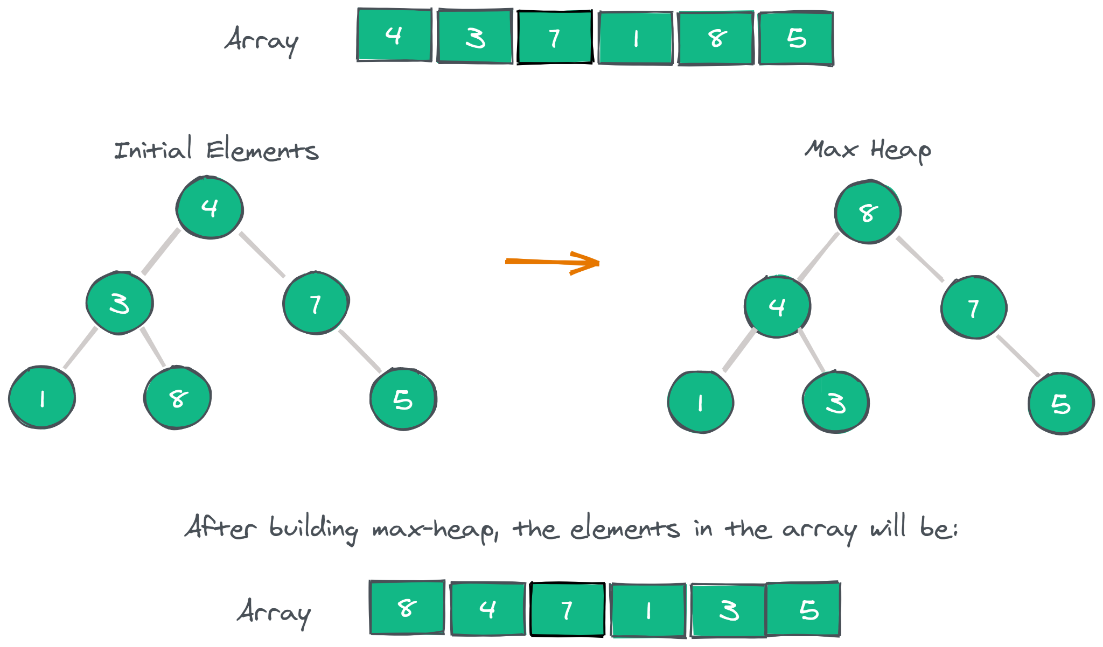
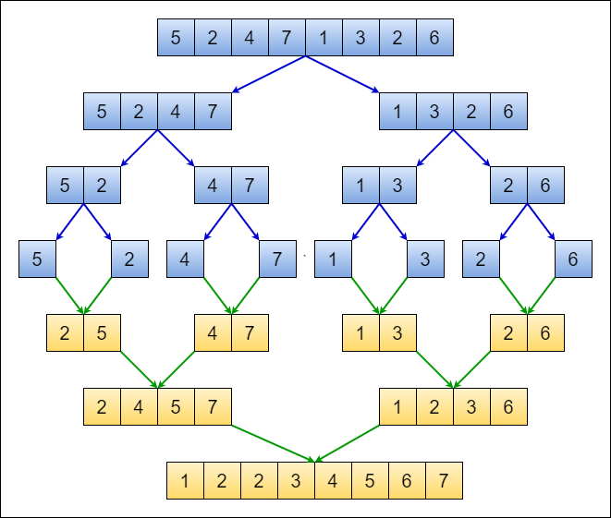
Problem Statement - Sorting Algorithms
Goal : To implement Heap and Merge sort in Java and Python
Heap Sort
Merge Sort

Slide 6
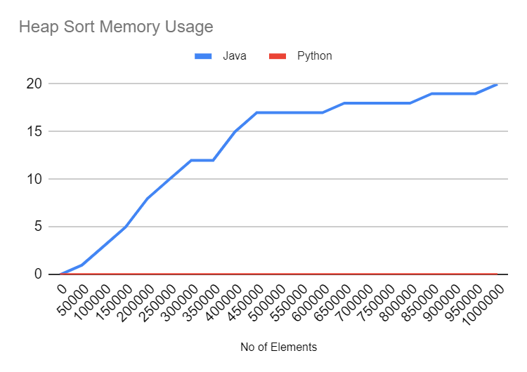
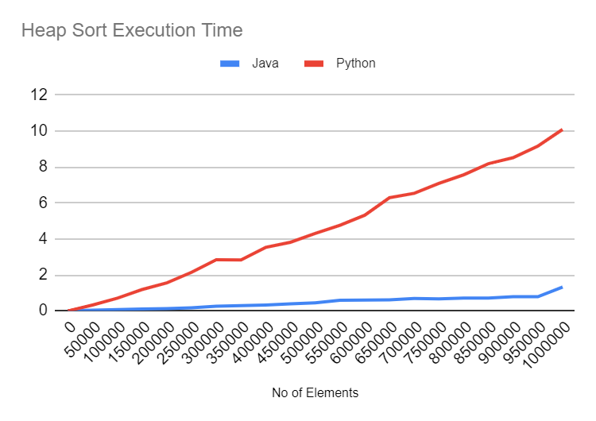
Evaluation - Heap Sort

Slide 7
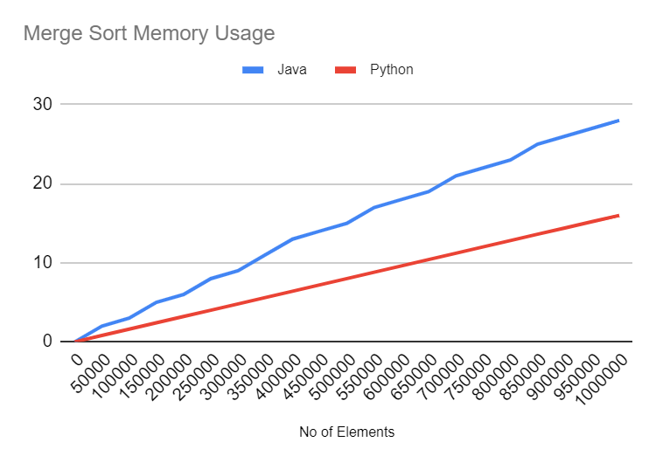
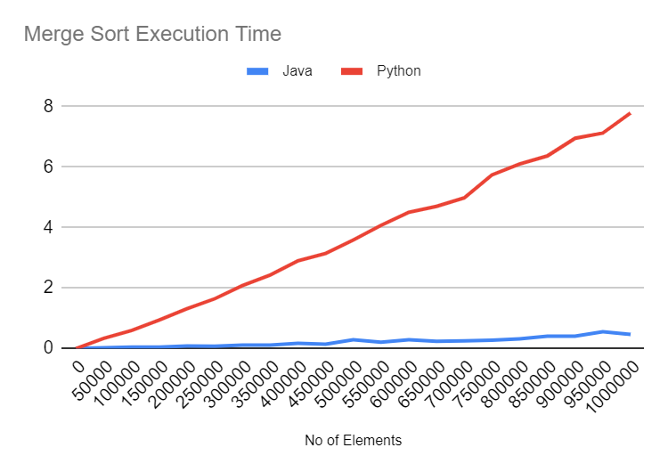
Evaluation - Merge Sort

Slide 8
Interpretation
Java uses more memory than python.
Garbage Collector
Java is a garbage-collected language. In order for the garbage collector to know which objects are eligible for collection, it needs to keep track of the object graphs.
JIT Optimization
Java Virtual Machine optimizes the code during runtime. Again, to know which parts to optimize it needs to keep track of the execution of certain code parts
Unlike Java, Python manages objects by using reference counting. This means that the memory manager keeps track of the number of references to each object in the program

Slide 9
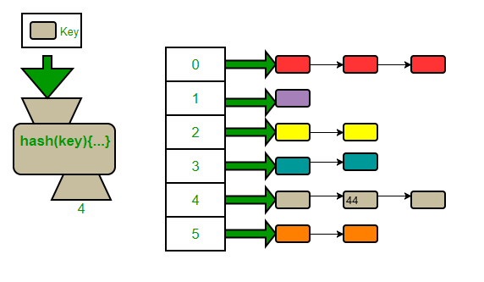
Problem Statement - Searching Data Structures
Goal : To implement Binary Search Tree and Hashing for searching in Java and Python
Hashing
Binary Search Tree

Slide 10
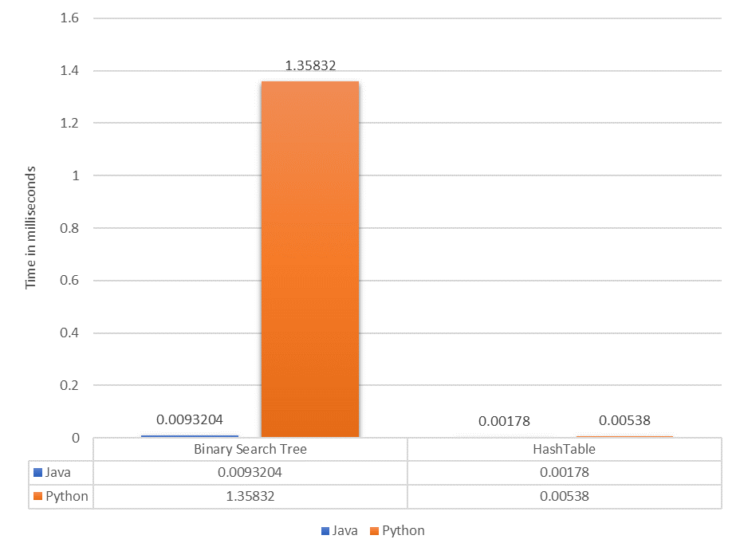
Evaluation - Creating Data Structures
Populating takes longer time in Python than Java
Java is a compiled language and comes with concurrency
Compiling does not require processor time and memory usage.
Python is interpreted which slows down programs during runtime.
Determining the variable type which occurs during runtime increases the workload of the interpreter
Notes:
Speed and efficiency differences between Python vs. Java
Java’s efficiency largely comes from its Just-In-Time (JIT) compiler and support for concurrency. The JIT compiler is a part of the Java Runtime Environment. It improves performance of Java programs by compiling bytecodes into native machine code “just in time” to run. Java Virtual Machine (JVM) calls the compiled code directly. Since the code is not interpreted, compiling does not require processor time and memory usage. Theoretically, this can make a Java program as fast as a native application.
While Java programs are compiled directly, Python is interpreted which slows down Python programs during runtime. Determining the variable type which occurs during runtime increases the workload of the interpreter. Also, remembering the object type of objects retrieved from container objects contributes to memory usage.

Slide 11
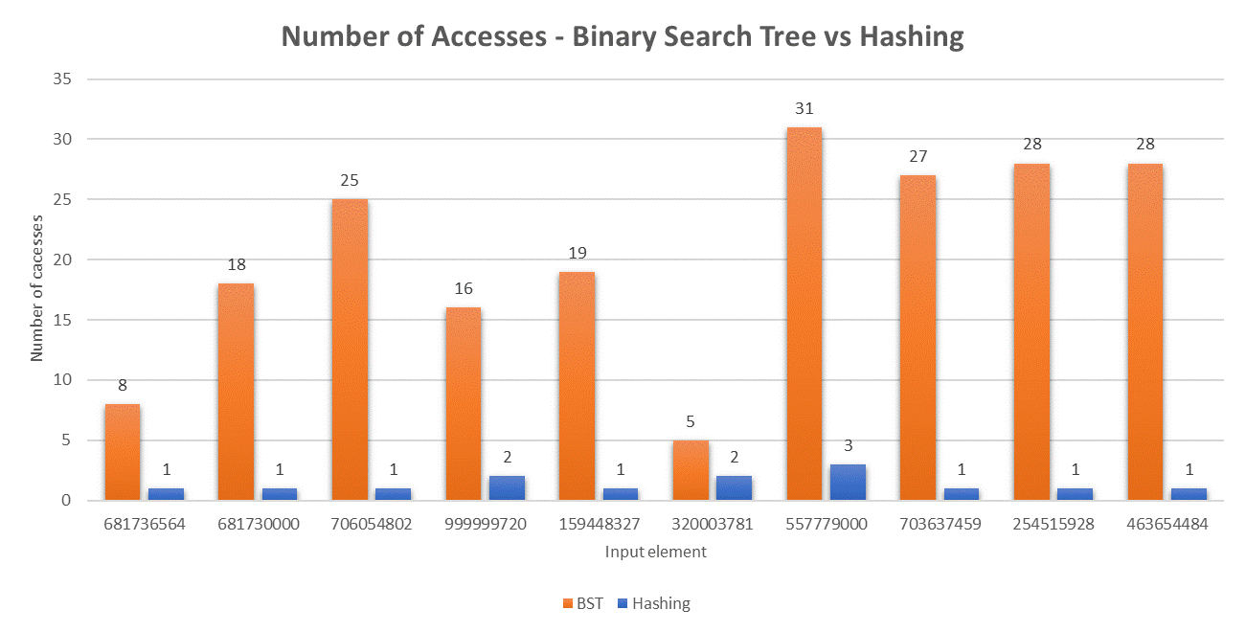
Evaluation - Number of Accesses

Slide 12
Evaluation - Time spent for Searching

Slide 13
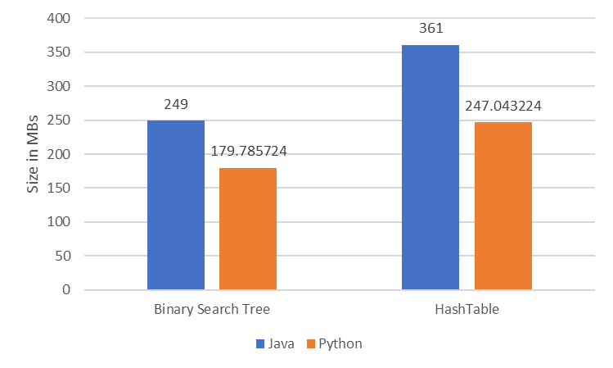
Evaluation - Memory used for creating Data Structure

Slide 14
Problem Statement - Concurrency
Goal : Sort 4 distinct single linked list using merge sort in a single threaded and multithreaded program.
Process
Process
Thread
Thread - 1
Thread - 2
Sort Linked List 1
Sort Linked List 1
Sort Linked List 2
Sort Linked List 2
Sort Linked List 3
Thread - 3
Thread - 4
Sort Linked List 4
Sort Linked List 3
Sort Linked List 4

Slide 15
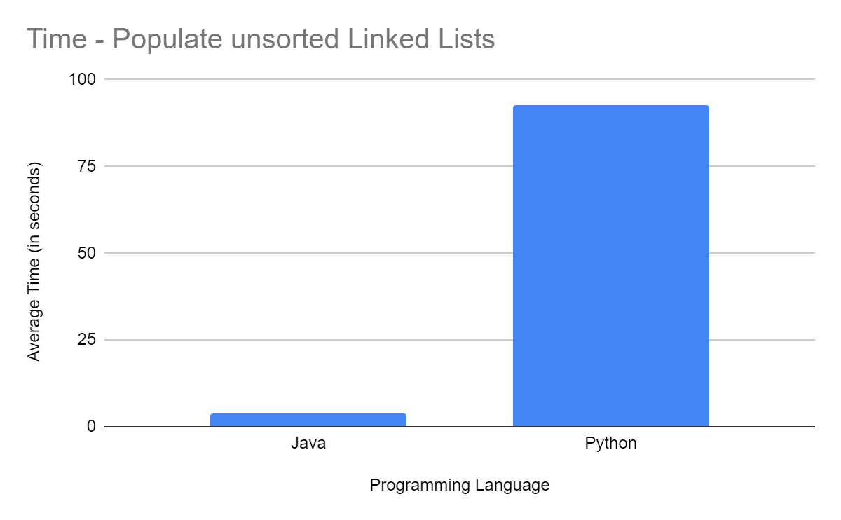
Evaluation - Populating Linked List
Programming style affects the performance of file processing
Python Program - uses inbuilt function readlines() - which returns all lines as string. Need a separate loop to convert all data to required data type.
Java Program - uses Scanner to read file contents line by line in the required data type (E.g nextLong())

Slide 16
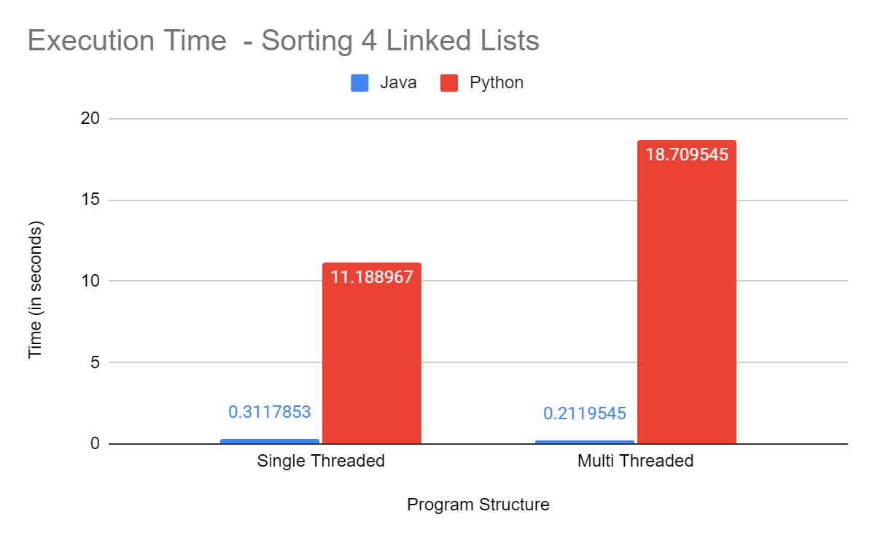
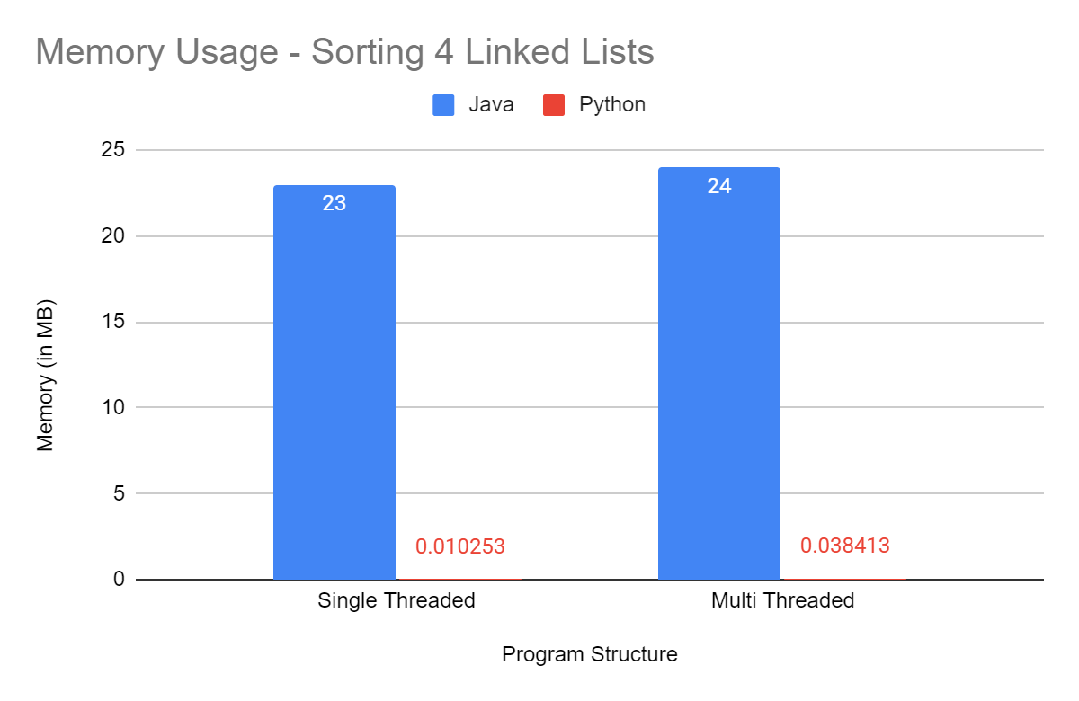
Evaluation - Sorting Time And Memory
Python multithreaded program slower than single threaded program ??????
Java program is faster in execution
Java program takes more memory than python

Slide 17
Multithreaded python program take more time than single threaded python program?
Python program uses CPU bound multi-threading which is slower in execution unless explicitly programmed for multi core processing.
Global Interpreter Lock is present in Python to prevent multiple threads to alter
memory, at the same time thus preventing memory corruption by only executing a single thread at a time.
Solution ?
Run each thread in separate cores. Use multiprocessing.

Slide 18
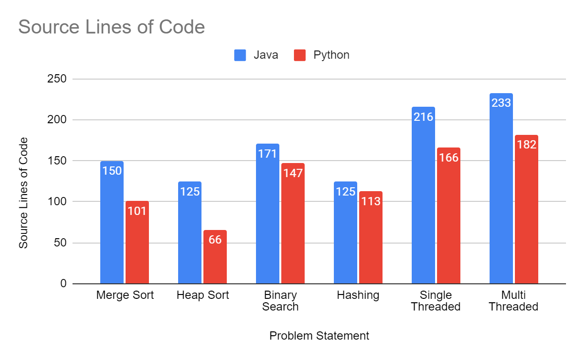
Evaluation Source Lines of Code

Slide 19
Conclusion
Which language is better?
Java is performance oriented. For performance critical application java is preferred.
Beginner friendly language, easy to learn. Good choice for learning programming.
Python code is shorter therefore reduces development time.
Java code is easier to debug due to its statically typed nature.
Best suited for data science and machine learning as lot of support available through external libraries.
Java handles concurrency better than python.

Slide 20
Q&A

